Slide 1
PET328
COMPUTER APPLICATIONS IN PETROLEUM ENGINEERING

Slide 2

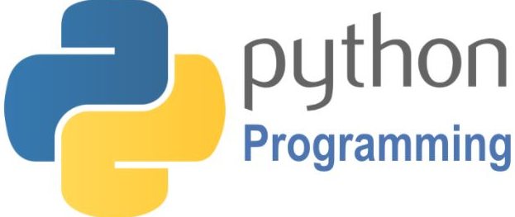
PET328: COMPUTER APPLICATIONS IN PETROLEUM ENGINEERING
(With Python Programming)
Olatunde O. Mosobalaje (PhD)
Department of Petroleum Engineering,
Covenant University, Ota
Nigeria

Slide 3


PET 328: Computer Applications in Petroleum Engineering – with Python Programming Dr. Mosobalaje, O. O.
OUTLINE
Preambles
The Appetizer
The Toolbox
The Embedded Course
Introduction to Computer Programming
Getting Started with Python
Python Objects
Conditional Execution
Repeated Execution
Functions
Python Data Structures
Strings
Lists
Tuples
Dictionaries
Some Python Libraries
NumPy
Matplotlib
Pandas
Scikit-learn
Application Projects
Oil Reservoir Volumetrics
Material Balance Analysis
PVT Properties

Slide 4
PET 328: Computer Applications in Petroleum Engineering – with Python Programming Dr. Mosobalaje, O. O.
PREAMBLES
The Appetizer – a presentation
ACQUIRING NASCENT SKILLS FOR EMERGING OIL AND GAS OPPORTUNITIES: DATA ANALYTICS, MACHINE LEARNING AND ARTIFICIAL INTELLIGENCE

Slide 5
PET 328: Computer Applications in Petroleum Engineering – with Python Programming Dr. Mosobalaje, O. O.
PREAMBLES
The Toolbox
For this course, the following tools would be needed:
Python 3
Python Integrated Development and Learning Environment (IDLE)
Git and GitHub

Slide 6
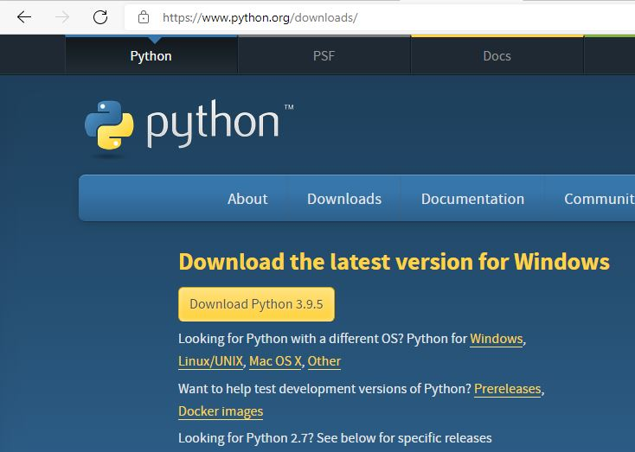
PET 328: Computer Applications in Petroleum Engineering – with Python Programming Dr. Mosobalaje, O. O.
PREAMBLES
The Toolbox
Installing Python 3
To install the latest release of Python 3, go to Python download website: https://www.python.org/downloads/

Slide 7
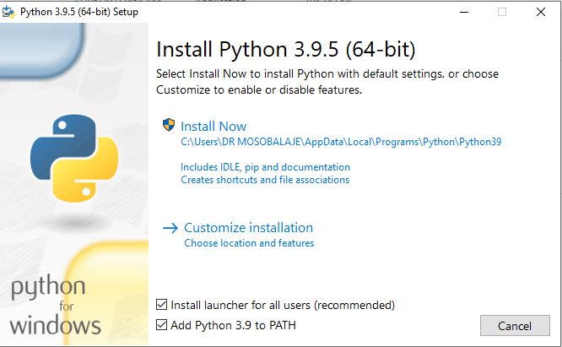
PET 328: Computer Applications in Petroleum Engineering – with Python Programming Dr. Mosobalaje, O. O.
PREAMBLES
The Toolbox
Installing Python 3
Launch the downloaded executable file by double-clicking the file in your download folder.
Follow the steps as the installer leads
Click on the default installation option.
Ensure to check the Add Python 3.9 to PATH

Slide 8
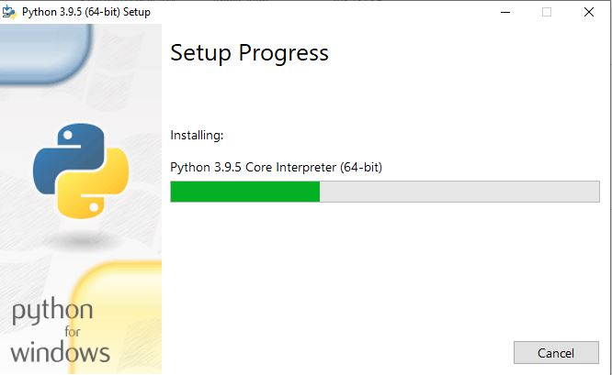
PET 328: Computer Applications in Petroleum Engineering – with Python Programming Dr. Mosobalaje, O. O.
PREAMBLES
The Toolbox
Installing Python 3

Slide 9
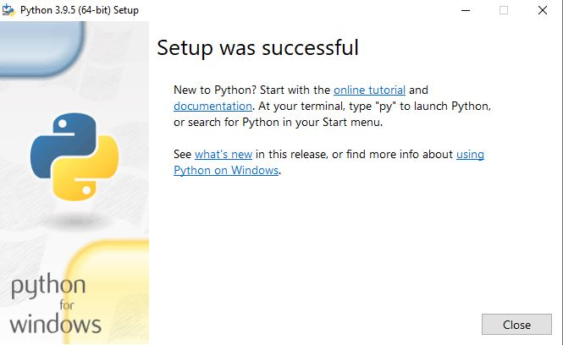
PET 328: Computer Applications in Petroleum Engineering – with Python Programming Dr. Mosobalaje, O. O.
PREAMBLES
The Toolbox
Installing Python 3
Click the close button when the installation is completed

Slide 10
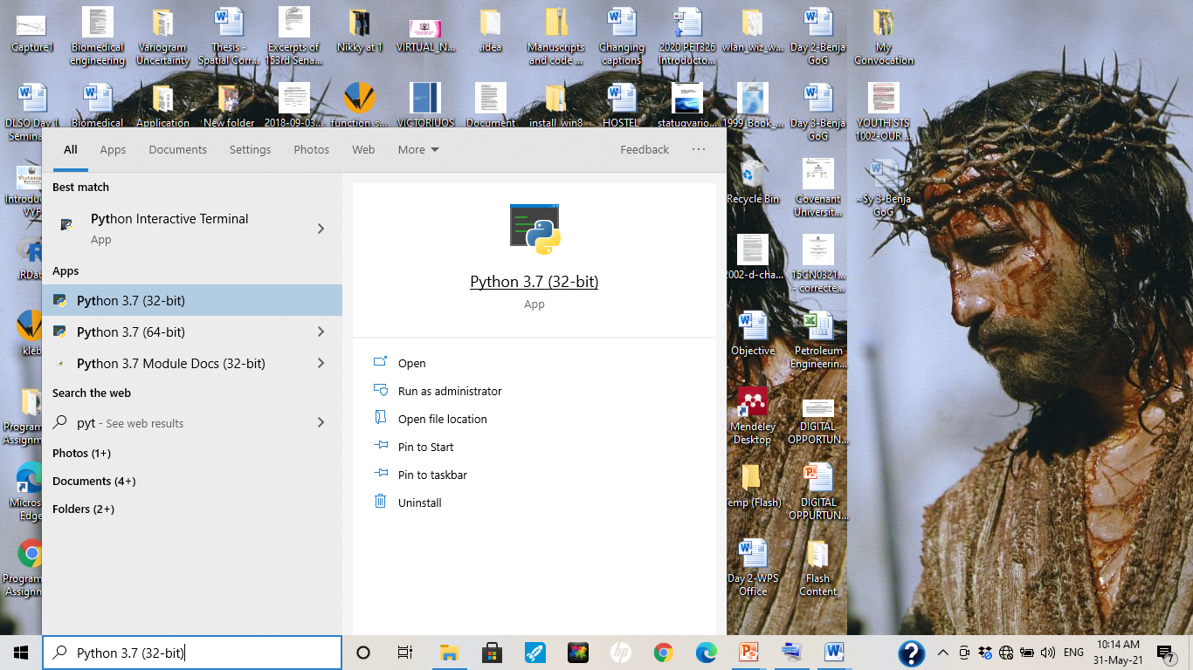
PET 328: Computer Applications in Petroleum Engineering – with Python Programming Dr. Mosobalaje, O. O.
PREAMBLES
The Toolbox
Launching Python 3
Simply type Python into the Start Menu search box and click the Python program.

Slide 11
PET 328: Computer Applications in Petroleum Engineering – with Python Programming Dr. Mosobalaje, O. O.
PREAMBLES
The Toolbox
Launching Python 3
Simply type Python into the Start Menu search box and click the Python program.

Slide 12
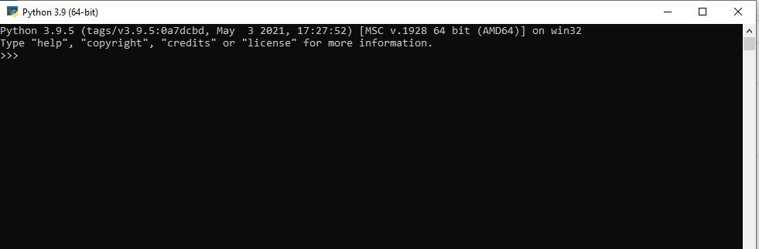
PET 328: Computer Applications in Petroleum Engineering – with Python Programming Dr. Mosobalaje, O. O.
PREAMBLES
The Toolbox
Launching Python 3

Slide 13
PET 328: Computer Applications in Petroleum Engineering – with Python Programming Dr. Mosobalaje, O. O.
PREAMBLES
The Toolbox
Python IDLE
Now, the Python DOS-like environment seems boring. Good enough, we will typically not be working on that platform; rather we will interact with Python from a platform known as Interactive Development and Learning Environment (IDLE)

Slide 14
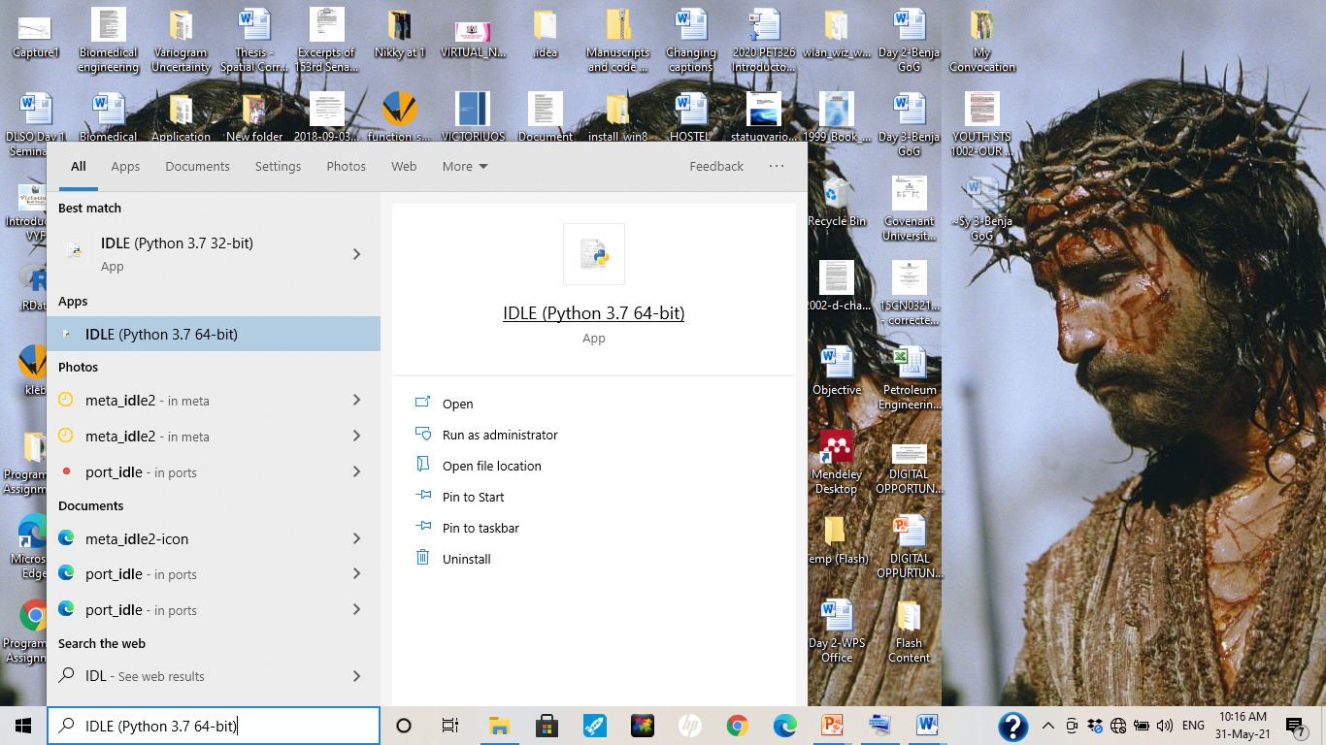
PET 328: Computer Applications in Petroleum Engineering – with Python Programming Dr. Mosobalaje, O. O.
PREAMBLES
The Toolbox
Python IDLE
To launch IDLE, simply type IDLE into the Start Menu search box and click on the IDLE program.

Slide 15
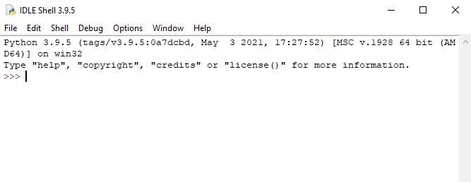
PET 328: Computer Applications in Petroleum Engineering – with Python Programming Dr. Mosobalaje, O. O.
PREAMBLES
The Toolbox
Python IDLE

Slide 16
PET 328: Computer Applications in Petroleum Engineering – with Python Programming Dr. Mosobalaje, O. O.
PREAMBLES
The Toolbox
Python IDLE
There are two ways by which you could communicate with Python from the IDLE environment:
Interactive
From a file (script)

Slide 17
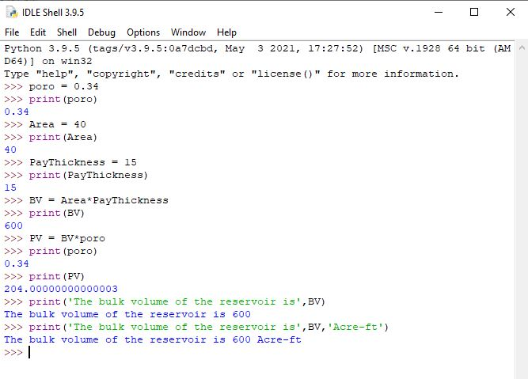
PET 328: Computer Applications in Petroleum Engineering – with Python Programming Dr. Mosobalaje, O. O.
PREAMBLES
The Toolbox
Communicating with Python interactively
In this case, you type in Python command (one at a time) into the console. Each command get executed once the ‘Enter’ key is pressed. Depending on the command, results may be displayed on the console once the command is executed.

Slide 18
PET 328: Computer Applications in Petroleum Engineering – with Python Programming Dr. Mosobalaje, O. O.
PREAMBLES
The Toolbox
Communicating with Python interactively
In this case, you type in Python command (one at a time) into the console. Each command get executed once the ‘Enter’ key is pressed. Depending on the command, results may be displayed on the console once the command is executed.

Slide 19
PET 328: Computer Applications in Petroleum Engineering – with Python Programming Dr. Mosobalaje, O. O.
PREAMBLES
The Toolbox
Communicating with Python from a file
In this case, you type in Python commands (all at a time) into a text file editor (code editor). The commands don’t get executed as they are being typed. Rather, they get executed (sequentially) when submitted as a whole to the Python interpreter.

Slide 20
PET 328: Computer Applications in Petroleum Engineering – with Python Programming Dr. Mosobalaje, O. O.
PREAMBLES
The Toolbox
Communicating with Python from a file
Any text editor program could be used for this purpose, as long as the file is saved as a .py file.
Good, Python has an in-built text editor for this purpose.

Slide 21
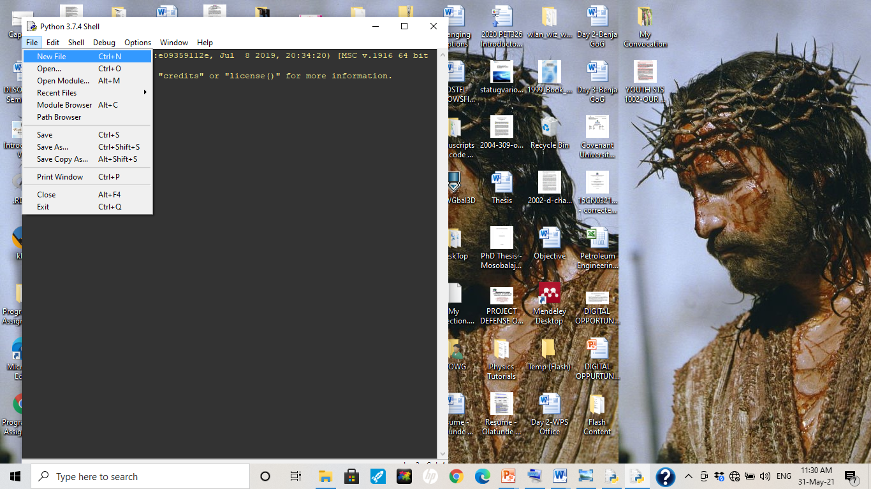
PET 328: Computer Applications in Petroleum Engineering – with Python Programming Dr. Mosobalaje, O. O.
PREAMBLES
The Toolbox
Communicating with Python from a file
To launch Python’s in-built code editor, just click on the File menu and choose New File.

Slide 22
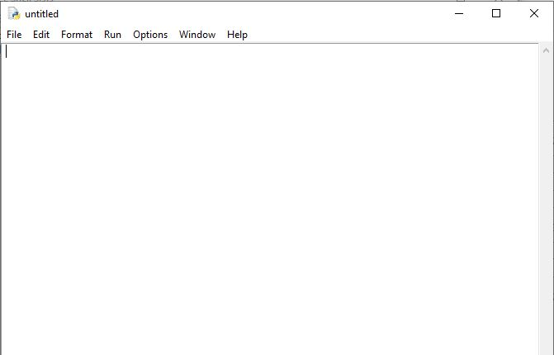
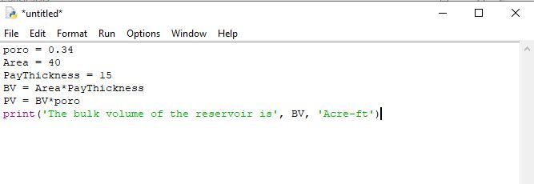
PET 328: Computer Applications in Petroleum Engineering – with Python Programming Dr. Mosobalaje, O. O.
PREAMBLES
The Toolbox
Communicating with Python from a file
Once the editor is opened, you can type in your lines of codes.

Slide 23
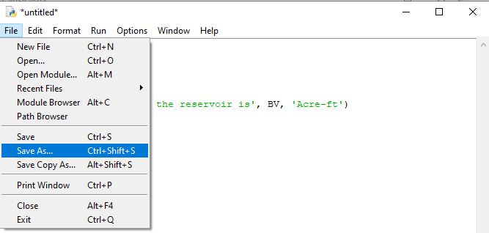
PET 328: Computer Applications in Petroleum Engineering – with Python Programming Dr. Mosobalaje, O. O.
PREAMBLES
The Toolbox
Communicating with Python from a file
Before submitting the lines of codes in the code editor to the Python interpreter, you need to save the editor file.
To save, simply go the File menu and choose Save As

Slide 24
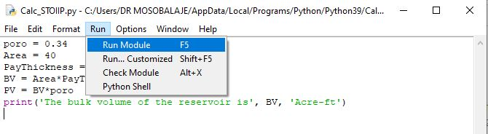
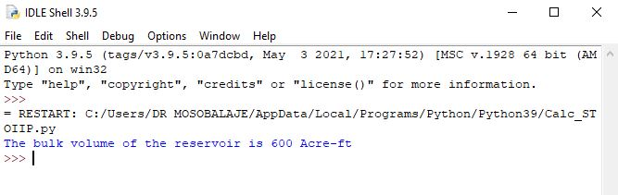
PET 328: Computer Applications in Petroleum Engineering – with Python Programming Dr. Mosobalaje, O. O.
PREAMBLES
The Toolbox
Communicating with Python from a file
Once the file (script) is saved, the code lines can be submitted to the Python interpreter by choosing item ‘Run Module’ in the Run menu.
The output of the code execution (if any) is subsequently displayed on the Python console.

Slide 25
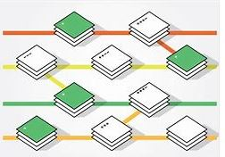


PET 328: Computer Applications in Petroleum Engineering – with Python Programming Dr. Mosobalaje, O. O.
PREAMBLES
The Toolbox
Git and GitHub
Git is an open source version control software.
What is Version Control?
Version control (VC) is a system used for keeping track of changes made to a file over time. As the changes are made, the system records and save the state of the file at instances indicated by the user. Such user can revert back to a previous version of the file when necessary.
Essentially, the VC system keeps the latest version of the file but also keeps a record of all changes between all versions.

Slide 26
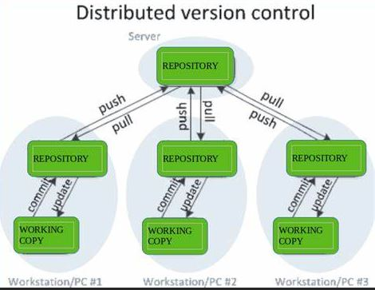
PET 328: Computer Applications in Petroleum Engineering – with Python Programming Dr. Mosobalaje, O. O.
PREAMBLES
The Toolbox
Git and GitHub
And, there is something called Distributed Version Control (DVC)
What is Distributed Version Control?
Typically, real life projects (including oilfield digital projects) are done by teams whose members need to collaborate – work together on same files. Individual members of the team can make changes to such shared files. There is therefore a need to make such file available on a central server and to keep track of the following:
who made what change?
When was the change made?
Why was the change made?

Slide 27
PET 328: Computer Applications in Petroleum Engineering – with Python Programming Dr. Mosobalaje, O. O.
PREAMBLES
The Toolbox
Git and GitHub
And, there is something called Distributed Version Control (DVC)
What is Distributed Version Control?
A version control system that also comes with the capabilities for collaboration among several people is known as Distributed Version Control system.
Git is a version control system – locally hosted on your system.
GitHub is an online platform that interfaces with Git, hosting your files on remote servers thereby making them available for collaboration with others.

Slide 28
PET 328: Computer Applications in Petroleum Engineering – with Python Programming Dr. Mosobalaje, O. O.
PREAMBLES
The Toolbox
Git and GitHub
In this course, we shall be working as a team, therefore, both Git and GitHub are part of tools we shall be using. Essentially, submissions to some assignments shall be in the form of code file editing and sharing between students and the Course Instructor.

Slide 29
PET 328: Computer Applications in Petroleum Engineering – with Python Programming Dr. Mosobalaje, O. O.
PREAMBLES
Assignment 1
Get the following tools ready on your PC:
Git - install
A user account on github.com
GitHub desktop - install

Slide 30

PET 328: Computer Applications in Petroleum Engineering – with Python Programming Dr. Mosobalaje, O. O.
PREAMBLES
The Embedded Course
A Coursera course is embedded into this course (PET328). It is compulsory that all students completes the Coursera course as it is part of the assessment items in PET328.

Slide 31

PET 328: Computer Applications in Petroleum Engineering – with Python Programming Dr. Mosobalaje, O. O.
PREAMBLES
The Embedded Course
The embedded course is titled ‘Programming for Everybody (Getting Started with Python).
The course is offered by University of Michigan.

Slide 32
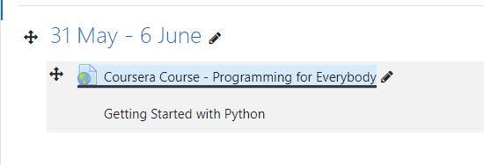
PET 328: Computer Applications in Petroleum Engineering – with Python Programming Dr. Mosobalaje, O. O.
PREAMBLES
The Embedded Course
The link to the embedded course has been added to the PET328 course site on Moodle.
To enroll for the Coursera course, simply click on the link.

Slide 33
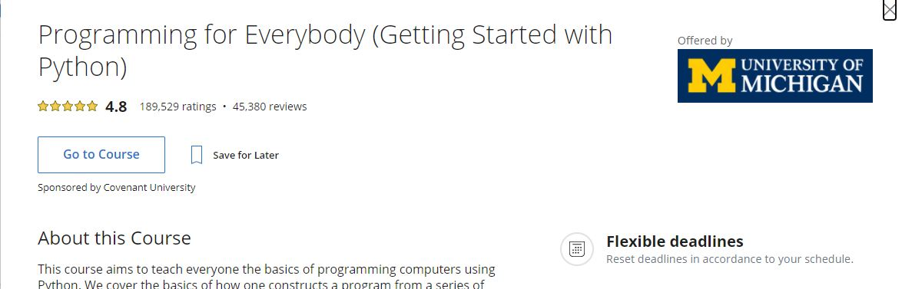
PET 328: Computer Applications in Petroleum Engineering – with Python Programming Dr. Mosobalaje, O. O.
PREAMBLES
The Embedded Course

Slide 34
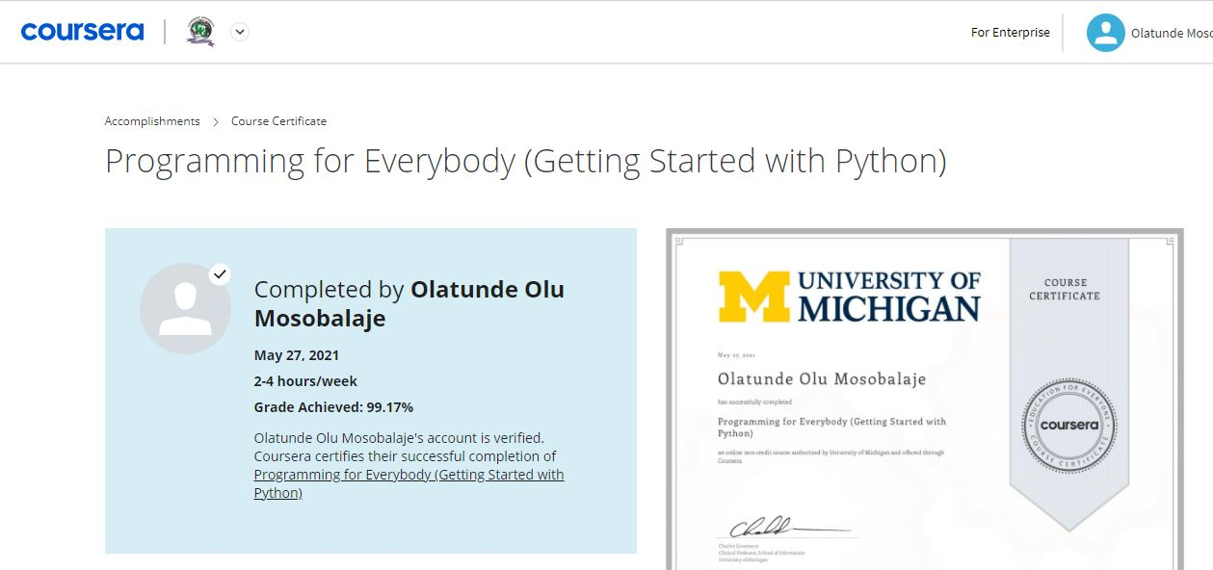
PET 328: Computer Applications in Petroleum Engineering – with Python Programming Dr. Mosobalaje, O. O.
PREAMBLES
The Embedded Course
When you complete the course, you are awarded a certificate of completetion!!!

Slide 35
PET 328: Computer Applications in Petroleum Engineering – with Python Programming Dr. Mosobalaje, O. O.
PREAMBLES
Introduction to Computer Programming
Analogy: Programming language vs. Natural language
There is a striking similarity between learning programming language and learning natural language. In both cases, the process is thus:
learn the vocabulary and the grammar – spell words, construct sentences etc.
Communicate
natural language: use words, sentences, paragraphs to communicate an idea
Programming language: use keywords, variables, functions, expressions, statements to communicate steps to computer.

Slide 36
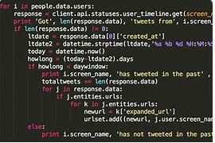
PET 328: Computer Applications in Petroleum Engineering – with Python Programming Dr. Mosobalaje, O. O.
PREAMBLES
Introduction to Computer Programming
A program is simply a collection of sequential Python statements written to perform a specific task

Slide 37
PET 328: Computer Applications in Petroleum Engineering – with Python Programming Dr. Mosobalaje, O. O.
PREAMBLES
Introduction to Computer Programming
Fundamental patterns (concepts) in a program
The following are typical patterns (statement(s)) you see in a program:
Input statements
Output statements
Sequential execution
Conditional statements
Repeated execution (loops)
Reuse of statements (functions)

Slide 38
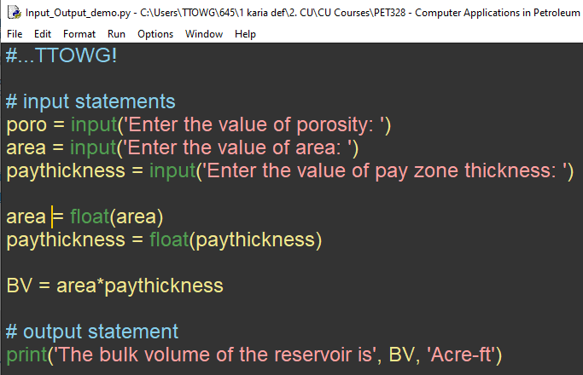
PET 328: Computer Applications in Petroleum Engineering – with Python Programming Dr. Mosobalaje, O. O.
PREAMBLES
Introduction to Computer Programming
Fundamental patterns (concepts) in a program
Input statements: - used to request and accept data from users
Example: the input function.

Slide 39
PET 328: Computer Applications in Petroleum Engineering – with Python Programming Dr. Mosobalaje, O. O.
PREAMBLES
Introduction to Computer Programming
Fundamental patterns (concepts) in a program
Output statements: - used to display the results of execution on the screen.
Example: the print function

Slide 40
PET 328: Computer Applications in Petroleum Engineering – with Python Programming Dr. Mosobalaje, O. O.
PREAMBLES
Introduction to Computer Programming
Fundamental patterns (concepts) in a program
Sequential execution: - typically, a program would entail multiple statements.
Statements are executed in the order (sequence) in which they are encountered.
Latter statements can make use of results of former statements; not vice-versa

Slide 41
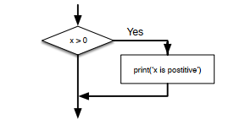
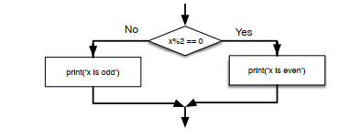
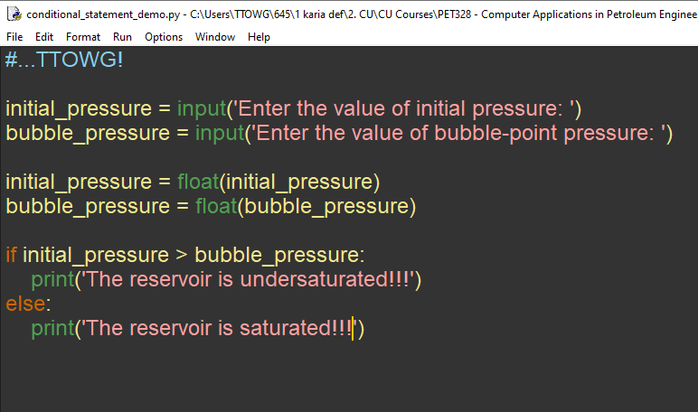
PET 328: Computer Applications in Petroleum Engineering – with Python Programming Dr. Mosobalaje, O. O.
PREAMBLES
Introduction to Computer Programming
Fundamental patterns (concepts) in a program
Conditional Statements: patterns that make it possible for the program to check for some conditions and decide to:
perform a statement(s) or skip the statement(s)
Choose between alternative statements.

Slide 42
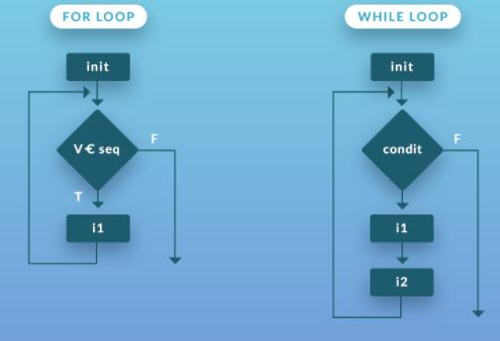
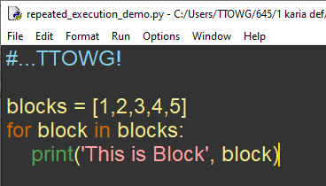
PET 328: Computer Applications in Petroleum Engineering – with Python Programming Dr. Mosobalaje, O. O.
PREAMBLES
Introduction to Computer Programming
Fundamental patterns (concepts) in a program
Repeated Execution: patterns that instructs the program to perform (iterate) a given statement(s) repeatedly, for each item in a set of items, varying values of parameter(s) from item to item.

Slide 43
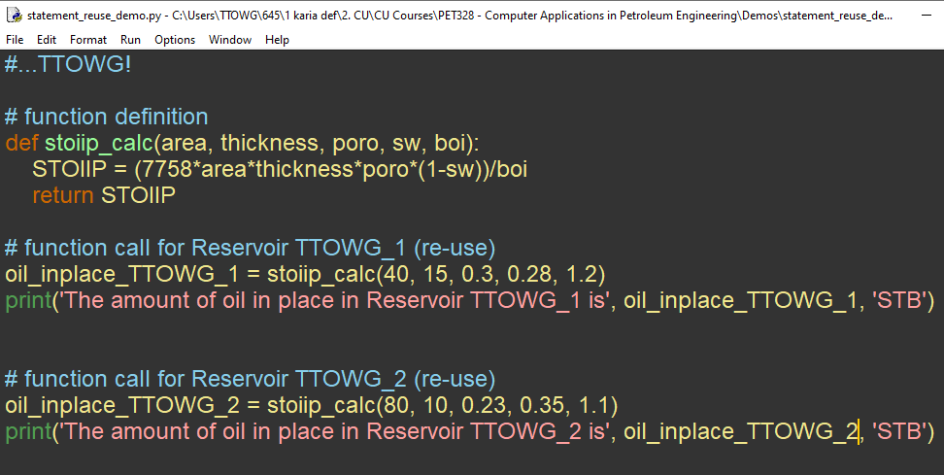
PET 328: Computer Applications in Petroleum Engineering – with Python Programming Dr. Mosobalaje, O. O.
PREAMBLES
Introduction to Computer Programming
Fundamental patterns (concepts) in a program
Re-use of statements: the task performed by some statement(s) might be routine and needed at various points in your program.
Such statement(s) may be written once, saved with a name and re-used at various points in your program by referring to the name.

Slide 44
>>>#TTOWG!
>>>print(‘…to the only wise God’)

Slide 45
PET 328: Computer Applications in Petroleum Engineering – with Python Programming Dr. Mosobalaje, O. O.
GETTING STARTED WITH PYTHON
Coming Soon…
Season 1 Episode 2 –
Getting Started with Python

